Slide 1
Hypothesis Testing
Mr. Sunanda Das
Assistant Professor, Dept. of CSE, KUET

Slide 2
What is Hypothesis Testing?
A statistical hypothesis is an assumption about a population parameter.
This assumption may or may not be true.
Hypothesis testing refers to the formal procedures used by statisticians to accept or reject statistical hypotheses.

Slide 3
Statistical Hypotheses
There are two types of statistical hypotheses.
Null Hypothesis (H₀)
State the assumed value of the parameter before sampling
It is a assumption that we wish to test
If a population mean is equal to hypothesized mean then the null hypothesis can be written as
H₀: µ = µ₀

Slide 4
Alternate Hypothesis (H_{a})
All possible alternate other than null hypothesis
If null hypothesis is H₀: µ = µ₀ then the alternate hypothesis can be written as
H_{a}: µ ≠ µ₀
H_{a}: µ > µ₀
H_{a}: µ < µ₀

Slide 5
Hypothesis Tests
Statisticians follow a formal process to determine whether to reject a null hypothesis, based on sample data.
This process, called hypothesis testing, consists of four steps.
1. State the hypotheses
This involves stating the null and alternative hypotheses. The hypotheses are stated in such a way that they are mutually exclusive. That is, if one is true, the other must be false.
2. Formulate an analysis plan
The analysis plan describes how to use sample data to evaluate the null hypothesis. The evaluation often focuses around a single test statistic.

Slide 6
3. Analyze sample data
Find the value of the test statistic (mean score, proportion, t statistic, z-score, etc.) described in the analysis plan.
4. Interpret results
Apply the decision rule described in the analysis plan. If the value of the test statistic is unlikely, based on the null hypothesis, reject the null hypothesis.

Slide 7
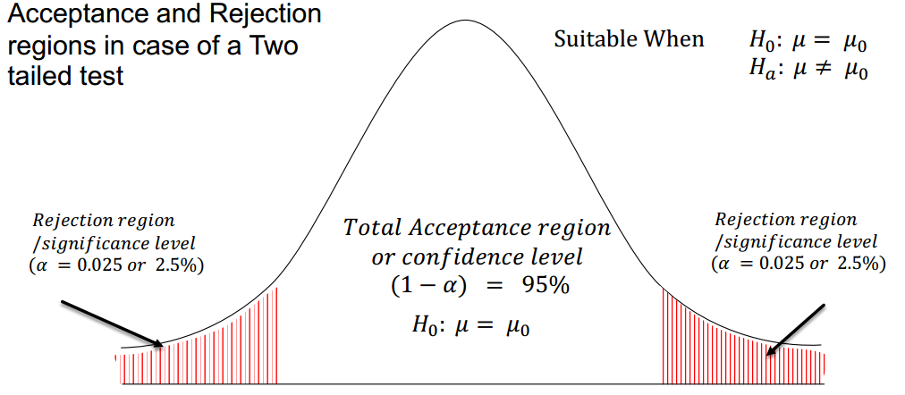
Two tailed test at 5% Significance level

Slide 8
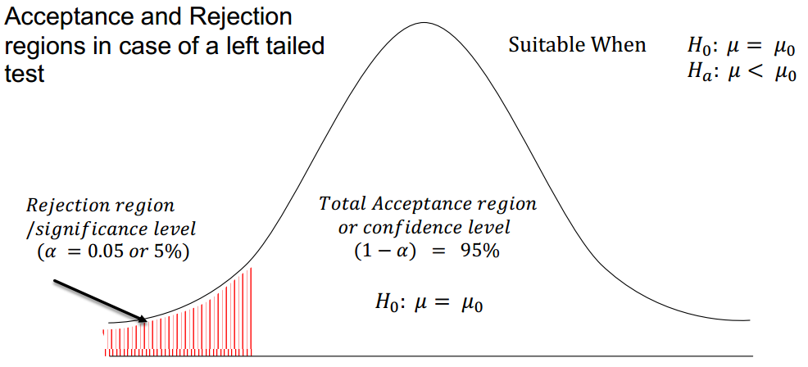
Left tailed test at 5% Significance level

Slide 9
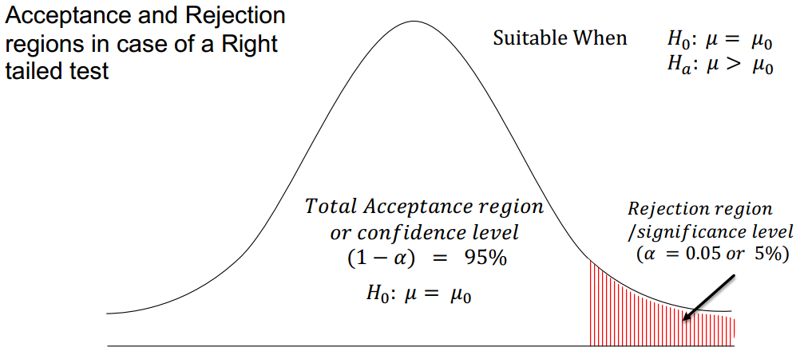
Right tailed test at 5% Significance level

Slide 10
Decision Errors
Type I Error
Rejection of the null hypothesis when it is true is called a type I error.
Rejecting H₀ in favor of H₁ when, in fact, H₀ is true. Such an error is called a type I error.
The probability of committing a Type I error is called the significance level.
This probability is also called alpha, and is often denoted by α.

Slide 11
Type II Error
Nonrejection of the null hypothesis when it is false is called a type II error.
We fail to reject H₀ when in fact H₀ is false. This is called a type II error.
The probability of committing a Type II error is called Beta, and is often denoted by β.

Slide 12
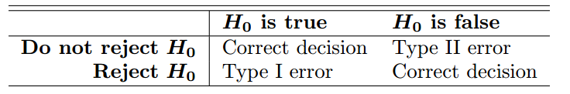

Slide 13
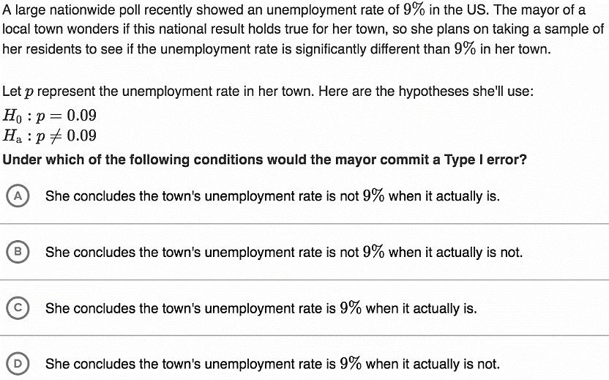

Slide 14

T test for a single mean
$$t=\frac{\overline{x}−μ_{0}}{\frac{s}{\sqrt{n}}}$$
$\overline{x}$ = sample mean
$μ_{0}$ = hypothesized population mean
$s$ = sample standard deviation
$n$ = sample size

Slide 15
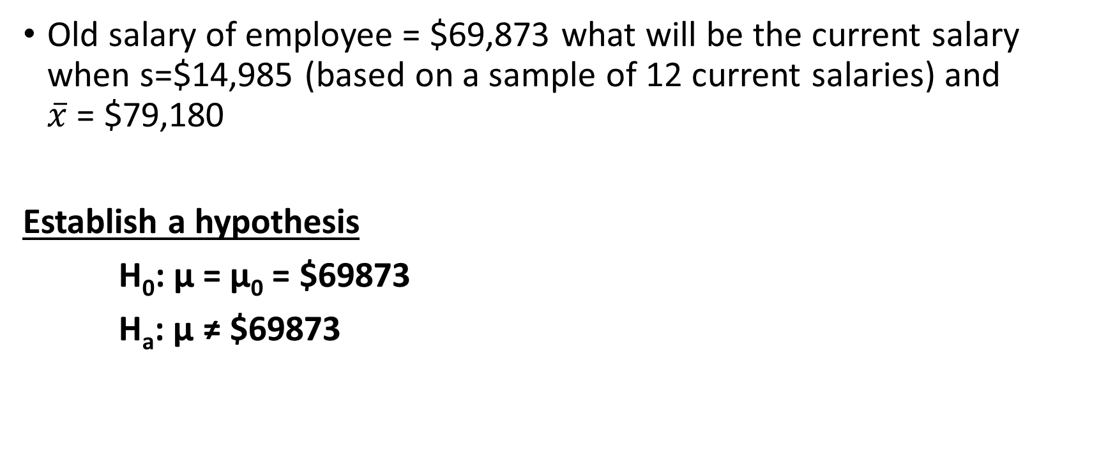
Old salary of employee = $69,873 what will be the current salary when s=$14,985 (based on a sample of 12 current salaries) and $\overline{x}$ = $79,180
Establish a hypothesis
H₀: µ = µ₀ = $69873
H_{a}: µ ≠ $69873

Slide 16
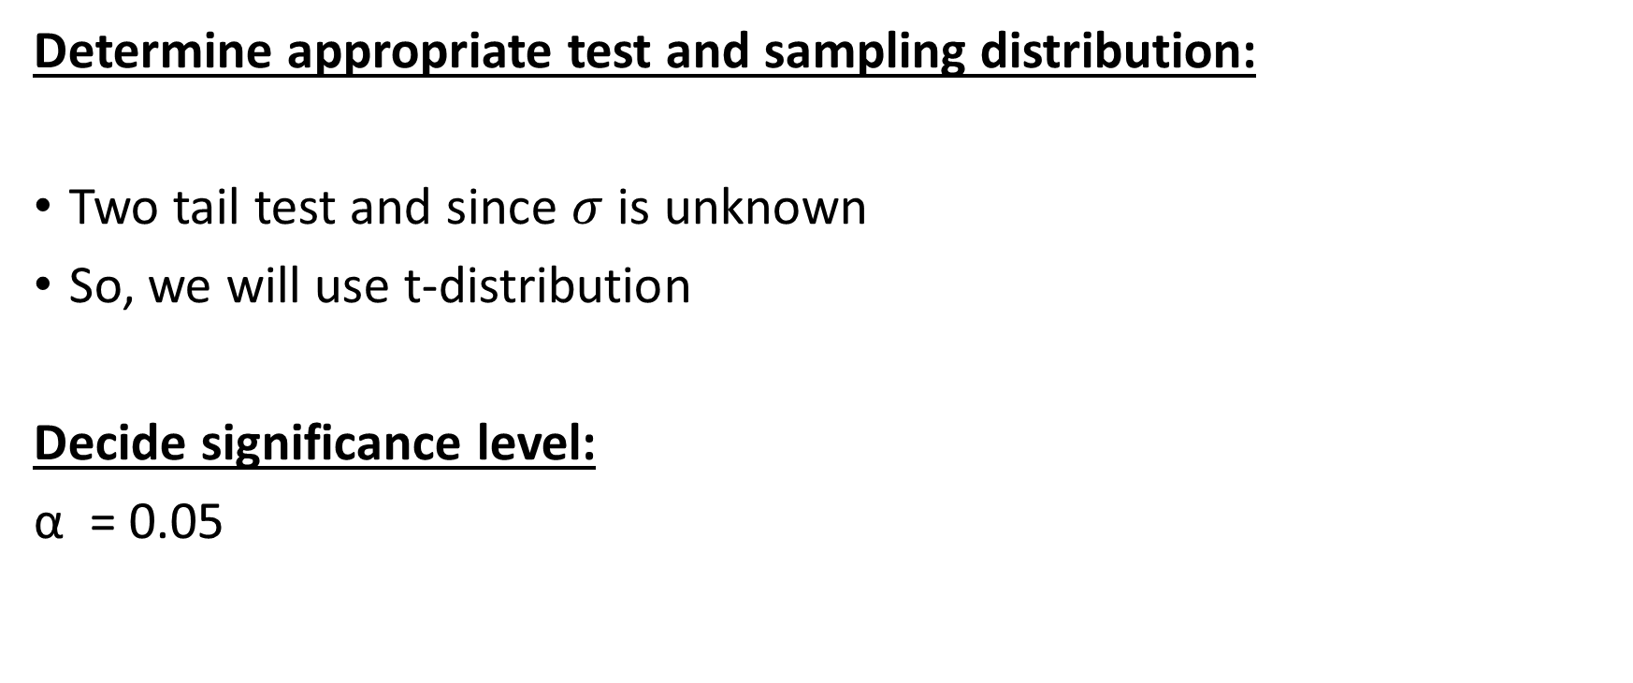
Determine appropriate test and sampling distribution:
Two tail test and since $σ$ is unknown
So, we will use t-distribution
Decide significance level:
α = 0.05

Slide 17
Now sample size n =12, df = 12-1 = 11
Hence, if t >2.201 then reject H₀
if t <-2.201 then reject H₀

Slide 18

$t=\frac{\overline{x}−μ_{0}}{\frac{s}{\sqrt{n}}}$
$=\frac{79180−69873}{\frac{14985}{12}}$
= 2.15
2.15<2.201
So, we fail to reject the null hypothesis H₀

Slide 19

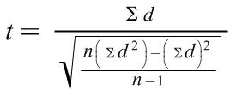

Paired T Test
Choose the paired t-test if you have two measurements on the same item, person or thing.
$H_{0}:μ_{pre}=μ_{post}$
$H_{a}:μ_{pre}≠μ_{post}$

Slide 20
subject | Score1 | Score2
1 | 3 | 20
2 | 3 | 13
3 | 3 | 13
4 | 12 | 20
5 | 15 | 29
6 | 16 | 32
7 | 17 | 23
8 | 19 | 20
9 | 23 | 25
10 | 24 | 15
11 | 32 | 30

Slide 21
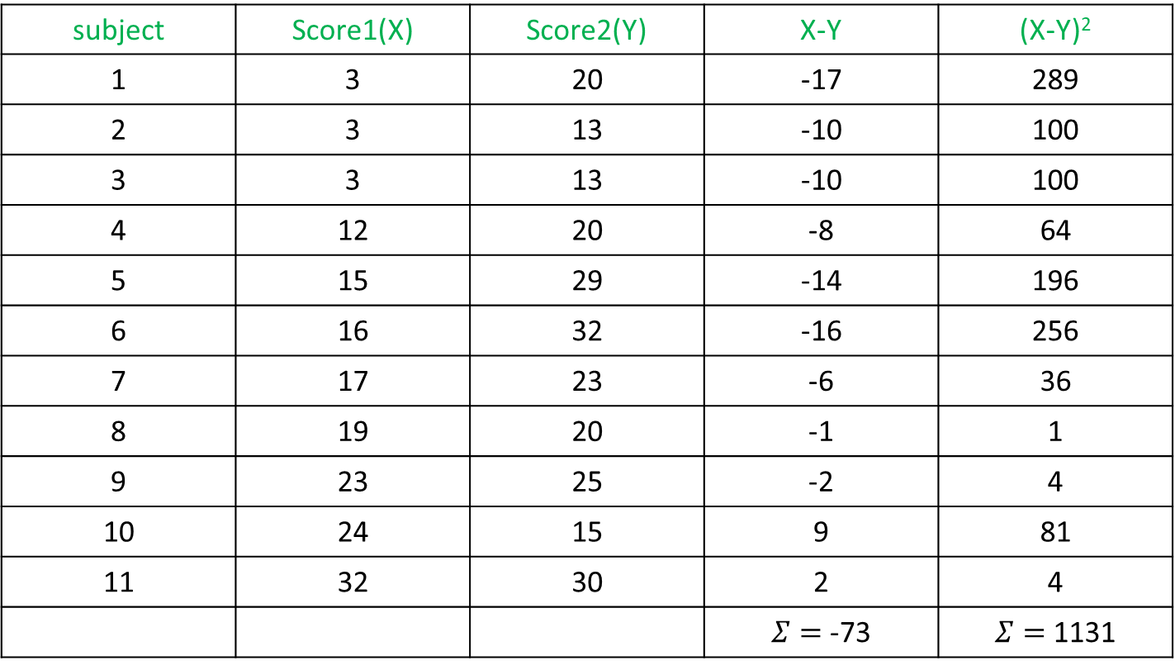
subject | Score1(X) | Score2(Y) | X-Y | (X-Y)²
1 | 3 | 20 | -17 | 289
2 | 3 | 13 | -10 | 100
3 | 3 | 13 | -10 | 100
4 | 12 | 20 | -8 | 64
5 | 15 | 29 | -14 | 196
6 | 16 | 32 | -16 | 256
7 | 17 | 23 | -6 | 36
8 | 19 | 20 | -1 | 1
9 | 23 | 25 | -2 | 4
10 | 24 | 15 | 9 | 81
11 | 32 | 30 | 2 | 4
 |  |  | $Σ=$-73 | $Σ=$1131

Slide 22
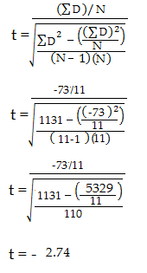
Significance level = (5%). For this sample problem, with df=10,
The t-value is (2.228, -2.228)
We can reject the null hypothesis that there is no difference between means.

Slide 23
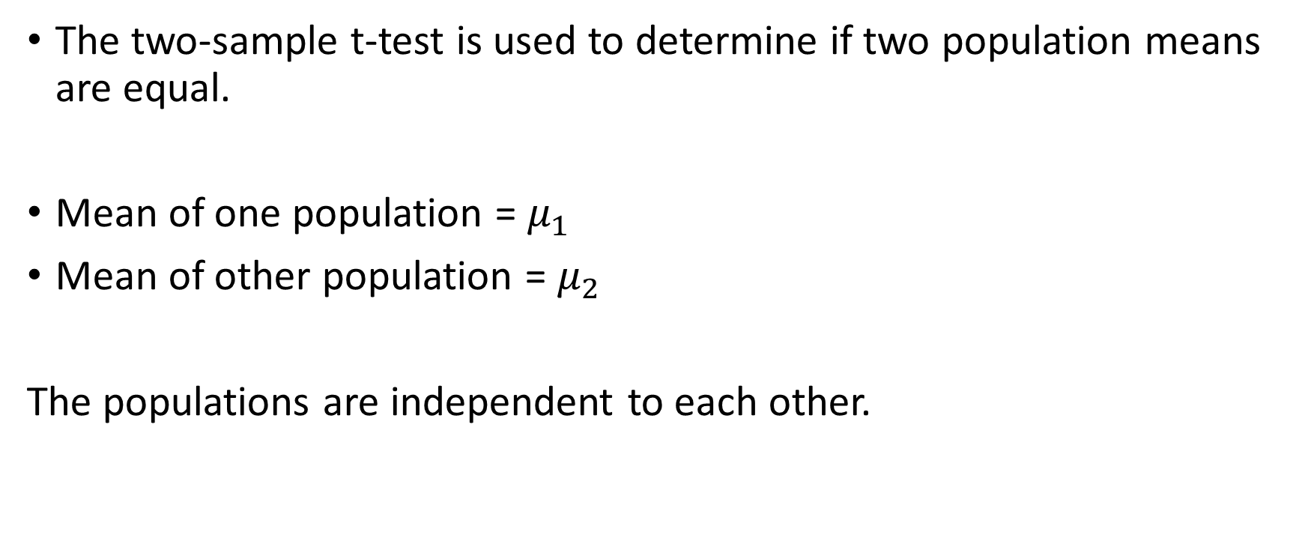
Two-Sample t-Test
The two-sample t-test is used to determine if two population means are equal.
Mean of one population = $μ_{1}$
Mean of other population = $μ_{2}$
The populations are independent to each other.

Slide 24
Difference between the two populations means is equal to some constant μ₁−μ₂=d₀
The two-sample t-test for the data is defined as
As, μ₁=μ₂ then μ₁-μ₂ = 0
H₀: | μ₁=μ₂
H_{a}: | μ₁≠μ₂

Slide 25
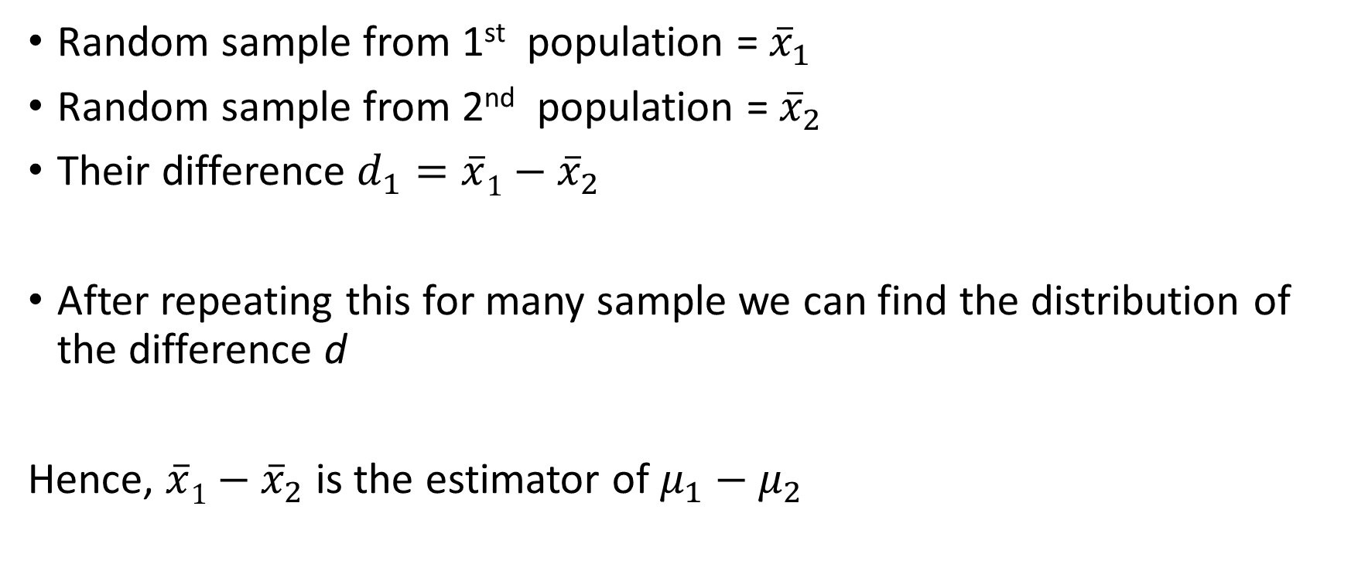
Random sample from 1st population = ${\overline{x}}_{1}$
Random sample from 2nd population = ${\overline{x}}_{2}$
Their difference $d_{1}=\overline{x}1−{\overline{x}}_{2}$
After repeating this for many sample we can find the distribution of the difference d
Hence, $\overline{x}1−{\overline{x}}_{2}$ is the estimator of $μ_{1}−μ_{2}$

Slide 26
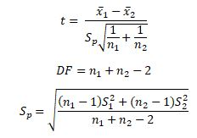
Two Sample T Test (Equal Variance)
Where n₁ and n₂ are sample sizes
x̅₁ and x̅₂ are means of sample sizes

Slide 27
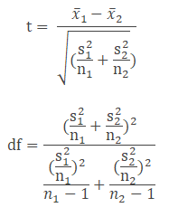
Two Sample T Test (Unequal Variance)
n₁ and n₂ are sample sizes
S₁² & S₂² are variances of sample 1 and sample 2
x̅₁ and x̅₂ are means of sample sizes

Slide 28
In a factory, samples are extracted from the Machine A and Machine B Assuming the population variance is unequal, at 95% confidence level we have to figure it out whether Machine A and B are producing of equal mean or mean of both the machine have been changed?
Machine A | Machine B
140 | 134
142 | 152
144 | 167
142 | 140
141 | 130

Slide 29
Null Hypothesis -> Mean of Machine A =Mean of Machine B
Alternate Hypothesis: Mean of Machine A not equal to Mean of Machine B

Slide 30
Parametric and Nonparametric Tests
The term "non-parametric" refers to the fact that the chi‑square tests do not require assumptions about population parameters nor do they test hypotheses about population parameters.
Previous examples of hypothesis tests, such as the t tests and analysis of variance, are parametric tests and they do include assumptions about parameters and hypotheses about parameters.

Slide 31
The most obvious difference between the chi‑square tests and the other hypothesis tests we have considered (t and ANOVA) is the nature of the data.
For chi‑square, the data are frequencies rather than numerical scores.

Slide 32
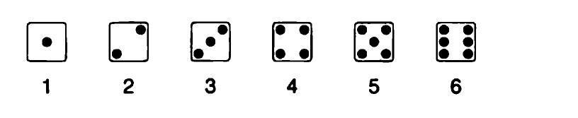
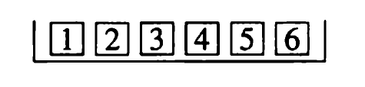
Categorical Random Variable
The Box Model
The random variable is not Numerical
The random variable is “Categorical”
There are 6 mutually exclusive categories
Each observation falls in one and only one category
We don’t calculate the average number of spots of the observations
We tabulate the frequency with which each category occurs

Slide 33
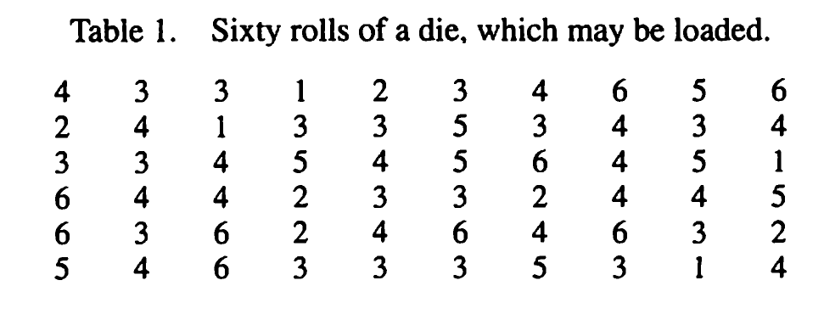
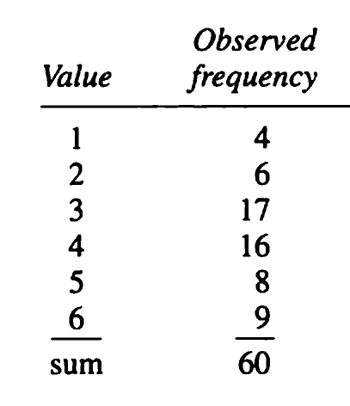
Observed frequencies
Roll the die n = 60 times.
The sample average is 3.75;
but we are interested in the total distribution

Slide 34
Chi-Square Test (Test for Independence )
The chi-square independence test is a procedure for testing if two categorical variables are related in some population.
Example:
a scientist wants to know if education level and marital status are related for all people in some country.
He collects data on a simple random sample of n = 300 people, part of which are shown below.

Slide 35
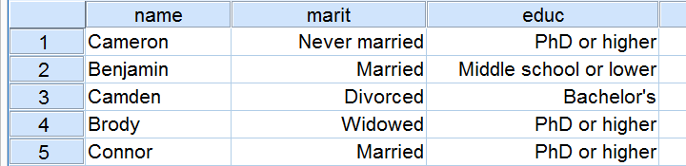

Slide 36
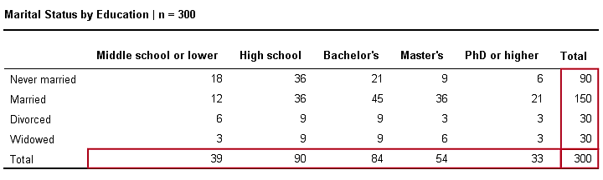
Observed Frequencies
there's 4 marital status categories and 5 education levels;

Slide 37
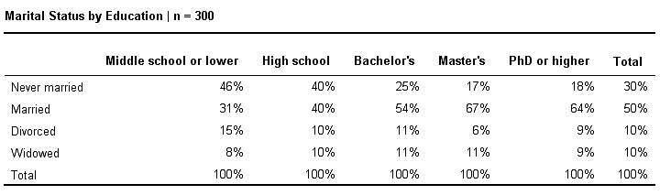
Column Percentages
is marital status related to education level ??

Slide 38
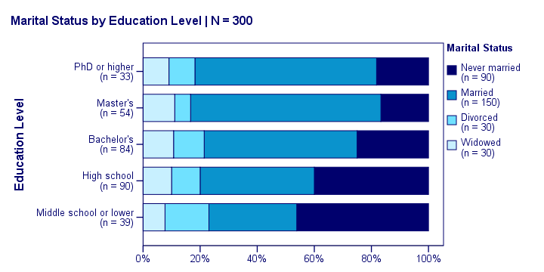
Stacked Bar Chart
Marital status is clearly associated with education level.

Slide 39
Null Hypothesis
The null hypothesis for a chi-square independence test is that
two categorical variables are independent in some population.
independence means that one variable doesn’t “say anything” about another variable.

Slide 40

Expected Frequencies
Expected frequencies are the frequencies we expect in our sample if the null hypothesis holds.
These expected frequencies are calculated as
eij is an expected frequency;
oi is a marginal column frequency;
oj is a marginal row frequency;
N is the total sample size.

Slide 41

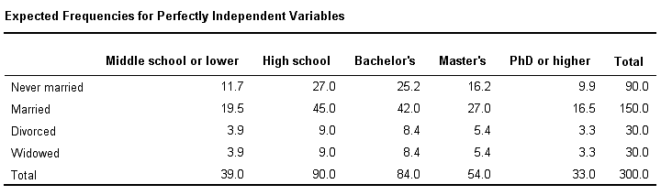
Expected Frequency
So for our first cell, that'll be

Slide 42


Test Statistic
The chi-square test statistic is calculated as

Slide 43

degrees of freedom
i is the number of rows in our table and
j is the number of columns
df=(5−1)⋅(4−1)=12.

Slide 44
And with df = 12, the probability of finding χ² ≥ 23.57 ≈ 0.023
It basically means, there's a 0.023 (or 2.3%) chance of finding this association
Conclusion: marital status and education are related in our population.

Slide 45

Goodness-of-Fit Test
The test is based on how good a fit we have between the frequency of occurrence of observations in an observed sample and the expected frequencies obtained from the hypothesized distribution.
we consider the tossing of a die.
We hypothesize that the die is honest, which is equivalent to testing the hypothesis that the distribution of outcomes is the discrete uniform distribution

Slide 46
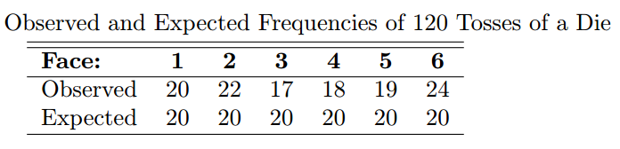
Suppose that the die is tossed 120 times and each outcome is recorded.
Theoretically, if the die is balanced, we would expect each face to occur 20 times.

Slide 47
The decision criterion described here should not be used unless each of the expected frequencies is at least equal to 5.
If the observed frequencies are close to the corresponding expected frequencies, the χ2-value will be small, indicating a good fit.
If the observed frequencies differ considerably from the expected frequencies, the χ2-value will be large and the fit is poor.
A good fit leads to the acceptance of H₀, whereas a poor fit leads to its rejection.

Slide 48

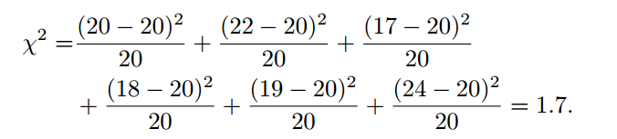

Slide 49
Degree of freedom v = 6-1 = 5
χ2_{0.05} = 11.070 for v = 5 degrees of freedom.
(where significance level α = 5%)
Since 1.7 is less than the critical value, we fail to reject H₀.
We conclude that there is insufficient evidence that the die is not balanced

Slide 50
The frequency distribution of battery lives is approximated by a normal distribution with mean μ = 3.5 and standard deviation σ = 0.7
The expected frequencies for the 7 classes (cells) are obtained by computing the areas under the hypothesized normal curve that fall between the various class boundaries.

Slide 51
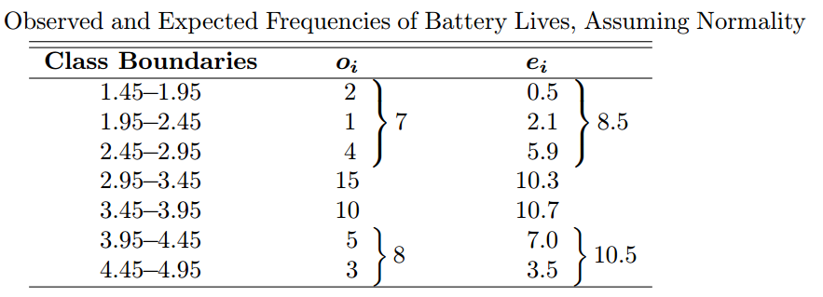

Slide 52



The z-values corresponding to the boundaries of the fourth class are
Hence, the expected frequency for the fourth class is

Slide 53

Degree of freedom v = 4 -1 = 3
(The total number of intervals is reduced from 7 to 4)

Slide 54
The computed χ2-value is less than χ2 _{0.05} = 7.815 for 3 degrees of freedom.
We have no reason to reject the null hypothesis.
Hence, the normal distribution with μ = 3.5 and σ = 0.7 provides a good fit for the distribution of battery lives.

Slide 55
References
https://stattrek.com/hypothesis-test/hypothesis-testing.aspx
https://www.statisticshowto.datasciencecentral.com/probability-and-statistics/t-test/
https://www.itl.nist.gov/div898/handbook/eda/section3/eda353.htm
https://www.data-stats.com/two-sample-t-test-hypothesis-testing-2/
https://sixsigmastudyguide.com/one-and-two-sample-t-tests/
https://www.spss-tutorials.com/chi-square-independence-test/
Probability & Statistics for Engineers & Scientists by Ronald E. Walpole, Raymond H. Myers, Sharon L. Myers, Keying Ye

